Slide 1
Database Management Systems -II
Md. Rezaul Karim, Ph.D.
CSEDU

Slide 2
Course Outline
DBMS Implementation Technology: (7)
Storage and File Structure: different storage types, RAID and RAID levels, file and record organization, data dictionary storage
Indexing and Hashing: basic concepts, ordered indices, B+-tree index files, B-tree index files, static & dynamic hashing, comparison of ordered indexing & hashing
Information Retrieval (5)
Query Processing: overview, measures of query costs, selection operation, sorting, join operation, other operations and evaluation of expressions.
Query Optimization: introduction, transformation of relational expressions, evaluation plan, cost-based optimization and heuristic optimization, optimizing nested sub-queries, materialized view and view maintenance

Slide 3
Course Outline
Introduction of Modern Databases: (3)
Object-relational and Object-oriented Databases: complex data types - structured, array and multiset types, inheritance, object identity and reference types, object-relational query, implementation, persistent programming languages, Introduction to other databases: temporal, spatial, multimedia and mobile databases.
Data Processing and visualization (3)
Data Object and Attribute Types: nominal, binary, ordinal, numeric, basic statistical description of data, measuring data similarity and dissimilarity
Data Preprocessing: data cleaning, integration and reduction, Data transformation and data discretization
Data Visualization: Pixel-oriented, geometric projection, icon based, hierarchical and visualizing complex data and relations.

Slide 4
Course outline
Database System Architecture: (7)
Centralized and client-server architecture;
Parallel Databases: architecture, speedup and scaleup, interconnection networks, I/O parallelism, interquery and intraquery parallelism, cost of parallel processing, design of parallel systems.
Distributed Databases: homogeneous and heterogeneous, distributed data storage: data replication and fragmentation, failure handling, distributed query processing.
Introduction to Data Mining and Machine Learning: (5)
Decision support systems, OLAP implementation
Data warehousing- components, schemas
Data mining concept, applications – association rules, classification, clustering

Slide 5
Text Books
Database System Concepts Authors: Abraham Silberschatz, Henry F. Korth, S. Sudarshan Edition: 7th Publication Year: 2019 Publisher: McGraw-Hill ISBN:978-0-07-802215-9 Web: http://www.db-book.com
Data Mining: Concepts and Techniques Authors: Jiawei Han, Micheline Camber, Jian Pie Edition: 4th Publication Year: 2023 Publisher: Morgan Kaufmann Publishers

Slide 6
Marks Distribution
Attendance 5%
Assignment 5%
Incourse 20%
Final 70%

Slide 7
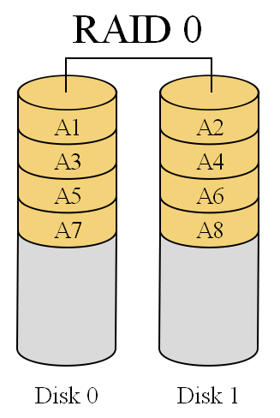
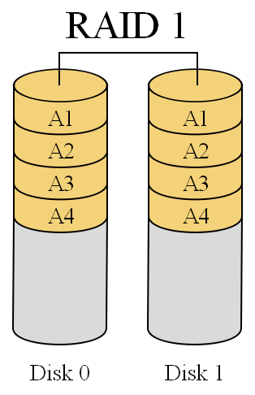
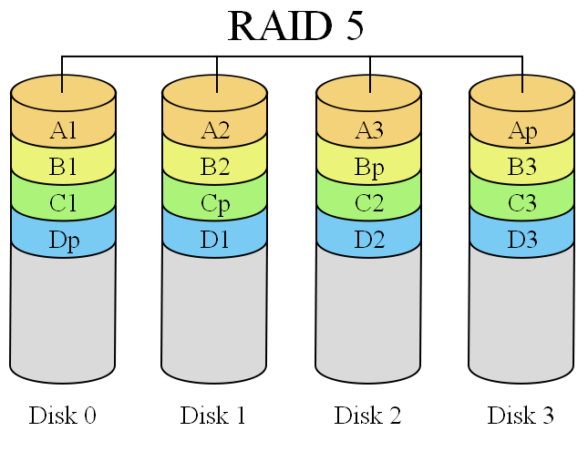
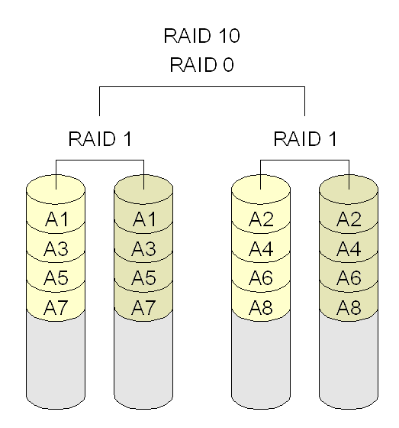

Slide 8
